Slide 1

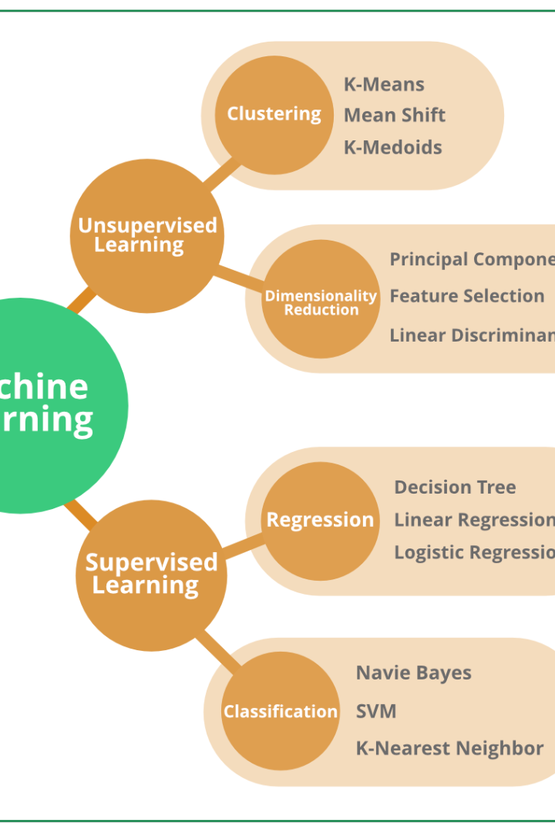
How Machine Learning Algorithms Can Help You Predict Sales Trends and Customer Behaviours
Discover how leveraging machine learning algorithms can revolutionize your ability to predict sales trends and understand customer behaviours.

Slide 2
Contents
Introduction
Steps Involved In Analysis
Algorithm Used In Future Sales Predict
Algorithm Used In Customer Behavior
Conclusion

Slide 3

Introduction
Effective sales and marketing decision making requires the ability to predict sales trends and understand customer behaviours. Machine learning algorithms offer powerful tools to achieve this.

Slide 4
Define Objectives and Scope
Clearly define the objectives of your product sales analysis
What specific questions or problems are you trying to address?
Examples could be understanding sales trends, identifying top-selling products,
forecasting future sales, or optimizing pricing strategies.

Slide 5
Data source
The dataset for the above mentioned project was obtained from kaggle website
Kaggle is an popular dataset providing source where obtained datasets are with high quality and less errors.

Slide 6
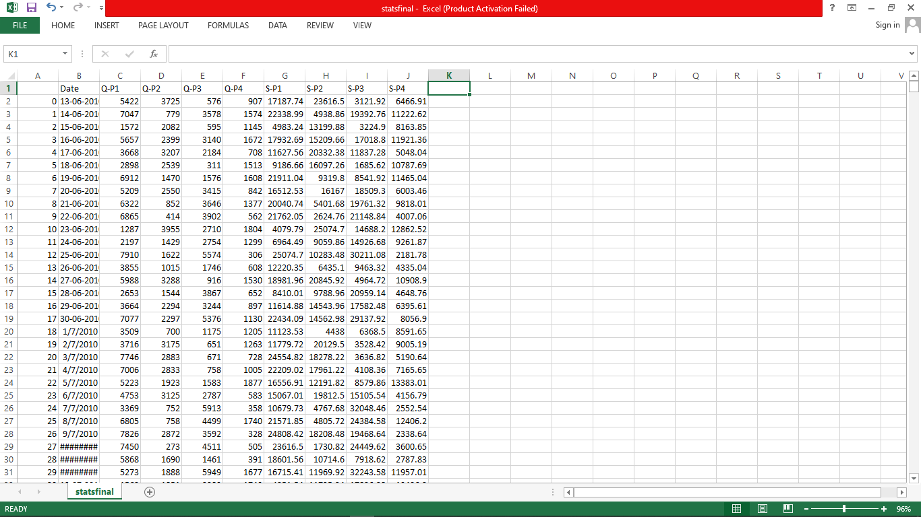
Imported dataset

Slide 7
Data cleansing
Filling missing value
Identify and decide how to deal with missing data points
(eg. imputation, removal, or interpolation).
Removing Duplicate Records:
Identify and remove identical or redundant rows in the dataset.
Handling Outliers:
Identify and decide whether to remove, transform, or keep outliers based on their impact on the analysis.
Standardizing Formats:
Ensure consistent formats for data (e.g., date formats, units of measurement) to avoid discrepancies.

Slide 8
Data Transformation and
Feature Engineering
create new features or variables that may be useful for analysis, such as calculating sales per product, sales growth rates, or customer lifetime value.

Slide 9
Predictive Modeling
Choose the appropriate machine learning algorithms for your sales prediction task.
Common choices include linear regression, time series forecasting models
(e.g., ARIMA or Prophet), or more advanced techniques like gradient boosting or neural networks.
Split your data into training and testing sets for model evaluation.
Train and fine-tune your model using the training data.
Evaluate model performance using metrics such as Mean Absolute Error (MAE), Mean Squared Error (MSE), or Root Mean Squared Error (RMSE).

Slide 10
Visualization and Reporting
Create interactive dashboards and visualizations to present your findings and insights.
Tools like Tableau, Power BI, or open-source libraries like Matplotlib and Seaborn can be used.
Generate regular reports to communicate results to stakeholders.

Slide 11

Types of Machine Learning Algorithms
1
Supervised Learning Algorithms
2
Unsupervised Learning Algorithms
3
Reinforcement Learning Algorithms
Train models using labeled data to make predictions or classifications.
Discover patterns and structures in unlabeled data without predefined categories.
Learn through interaction with an environment to maximize rewards and minimize penalties.

Slide 12
Predicting Sales Trends Using Machine Learning
Data Collection and Processing
Training and Testing the Model
Forecasting Sales Trends
Gather and clean relevant data to train the model, including historical sales data, market trends, and external factors.
Use the collected data to train the machine learning model and evaluate its accuracy and performance.
Utilize the trained model to predict future sales trends and identify potential areas for growth.

Slide 13
Algorithm used to predict Future sales
1. Time Series Forecasting Models
ARIMA (Auto Regressive Integrated Moving Average): ARIMA models are widely used for time series forecasting.
They can capture trends, seasonality, and autocorrelation in historical sales data.
Exponential Smoothing Methods: Methods like Holt-Winters and Triple Exponential Smoothing are effective for capturing seasonality and trends in time series data.
Prophet: Developed by Facebook, Prophet is designed for forecasting with daily observations that display patterns on different time scales. It can handle missing data and outliers.

Slide 14
2. Regression Models:
Linear Regression:
Simple linear regression can be used to model sales
as a function of time and other relevant features.
Multiple Regression:
When you have multiple predictors
(e.g., advertising spend, promotions, economic indicators),
multiple regression can be more appropriate.

Slide 15
3. Decision Trees and Ensemble Methods
Random Forest:
Random forests can capture complex relationships between sales and various factors.
They are robust and handle both categorical and numerical features well.
Gradient Boosting Machines (GBM):
GBM, including XG Boost and Light GBM, are powerful ensemble methods
that can handle non-linearity and interactions between features.

Slide 16
Understanding Customer Behaviours with Machine Learning
Clustering and Segmentation
Recommendation Systems
Personalization and Targeted Marketing
Utilize machine learning algorithms to group customers based on their similarities and segment insights for targeted marketing strategies.
Employ collaborative filtering and content-based filtering techniques to provide personalized recommendations to customers.
Deliver tailored marketing messages and experiences based on customer preferences and behaviours.

Slide 17
Algorithm used for Customer behavior
1. Logistic Regression
Used for binary classification problems, such as predicting whether a customer will make a purchase (yes/no).
It's simple and interpretable, making it a good choice when you want to understand the influence of individual features on customer behavior.

Slide 18
2. Support Vector Machines (SVM)
SVM can be used for binary classification problems, separating customers into different behavior categories.
It's particularly useful when dealing with high-dimensional data and cases where a clear margin of separation exists between classes.

Slide 19
3. Random Forest
Effective for both classification and regression tasks.
Can handle a large number of features and capture complex interactions between them.
Useful for predicting behaviors like product recommendations or customer churn.

Slide 20
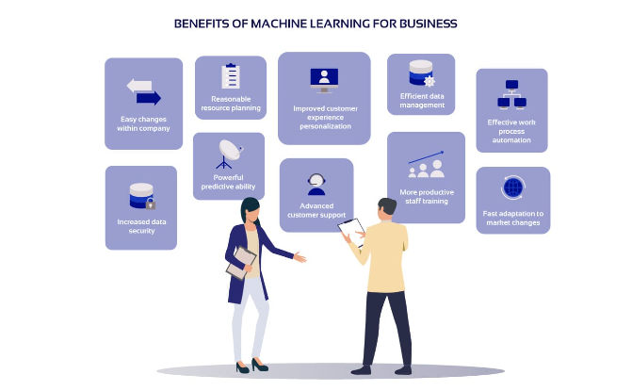
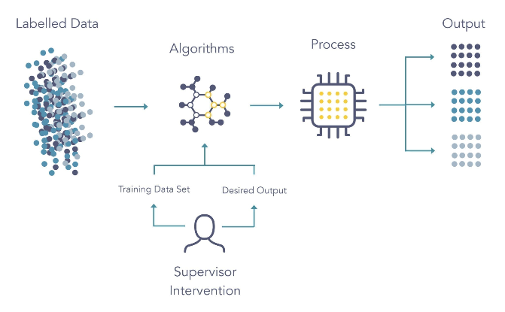
Benefits and Challenges of Using Machine Learning Algorithms
Increased Accuracy and Efficiency
Potential Limitations and Ethical Considerations
Machine learning algorithms can process large amounts of data quickly and make accurate predictions.
Challenges include data privacy, bias, and the need for human oversight.

Slide 21

Conclusion
By leveraging machine learning algorithms, businesses can gain valuable insights to drive sales and marketing decision making. Embrace this powerful technology to stay ahead of the competition.

